Slide 1
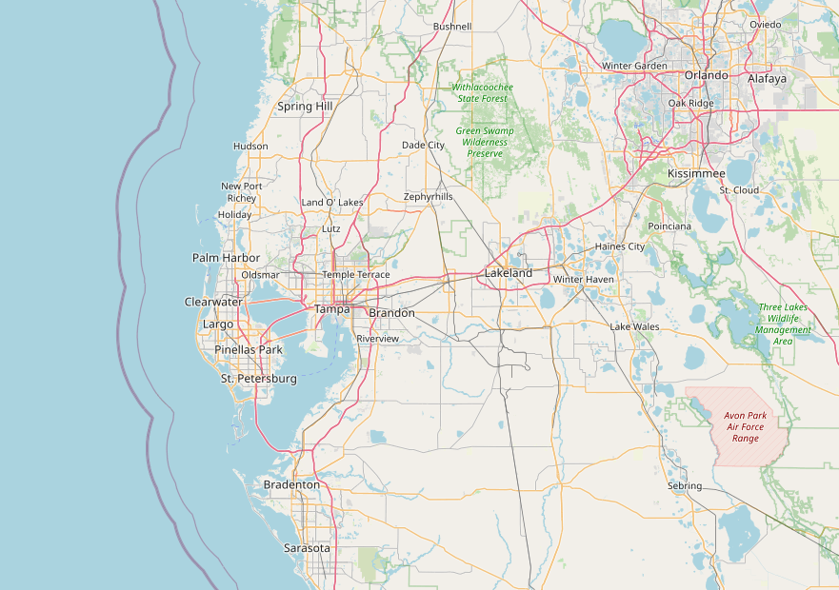
Coursera Capstone IBM Applied Data Science Capstone
Opening a Restaurant in Tampa (Florida)
By: V.K
July 2020

Slide 2

Table of Content
Business Problem
Data
Methodology
Exploring Tampa Neighborhood
Exploring Tampa Restaurant
Result
Discussion
Conclusion

Slide 3
Business Problem
Tampa is the 48th most-populous city in the U.S. and the third-largest city in Florida after Miami and Jacksonville. The population of the Tampa Bay MSA is estimated at 3,142,663 people as of 2018.
A recently released report analyzed 236 cities across the U.S., including the 150 most populous, to determine the 50 best cities to open a restaurant.
Bid on Equipment named Tampa the No. 13 best city to open a restaurant, using the key factors of annual restaurant sales per capita, competition and market saturation (restaurants per capita), workforce (the number of restaurant industry workers per capita) and medium income in each city
Let suppose, an investor has enough time and moneys, as well as a passion to open the best eating spot in Tampa. What type of restaurant would it be? What would be the best location for it?
Target audience: investors, entrepreneurs, and chefs interest in opening a restaurant in Tampa, who may require objective advice regarding what type exactly it should be opened.

Slide 4
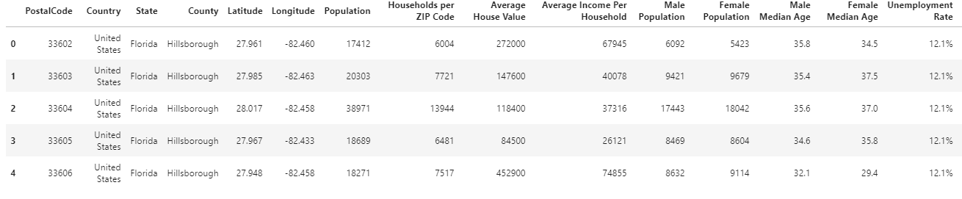
Data
Data Requirements for this project:
PostalCode information (i.e. name, coordinates, populations).
Venue information (i.e. name, category, coordinates)
Data Sources for this project:
Foursquare.com
US ZIP Code data. https://simplemaps.com/data/us-zips
Tampa City Data. https://www.tampagov.net/
Data Processing for this project:
Data Cleaning is required
Data needs to be in a structured format

Slide 5
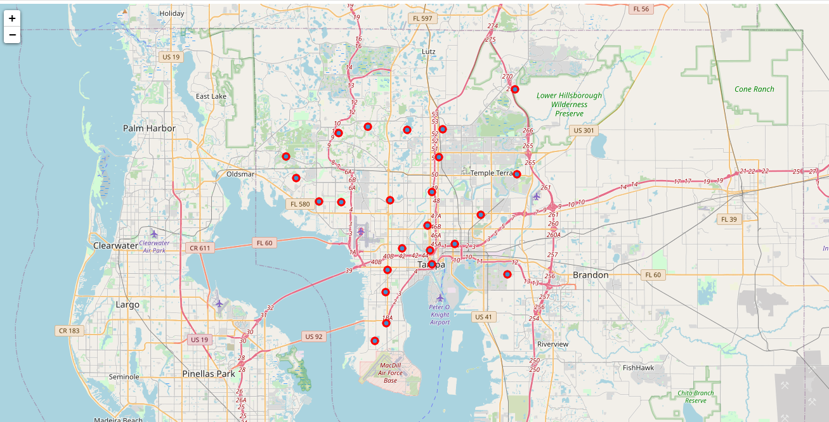
Methodology
Data Scrapping Technique internet page
To scrap the postalcode data from US ZIP code page
Using Forsquare API, collect the top 100 restaurants and their Categories for each location withing a 500 meter radius.
Group collected restaurants by location and by taking the mean of the frequency of occured of each type, preparing them for clustering.
Cluster restaurants by k-means algorithm analyze 10 most common restauirant in each cluster
Visualize cluster on the map, thus showing the best location for opening the chosen restaurant.

Slide 6
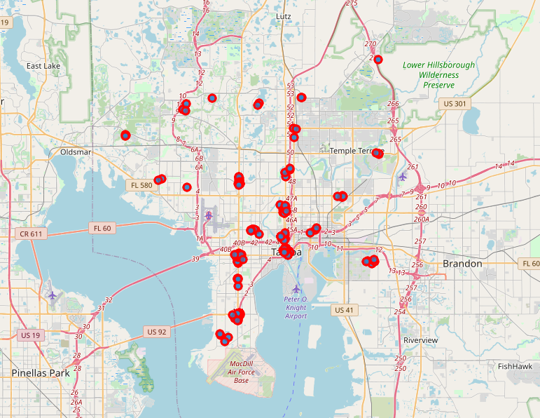
Exploring Tampa Neighborhoods
Using US ZIP code we collected all of Tampa’s neighborhoods.
Using geospatial libraries and Scraping ZIP codes we added geographical coordinates.
With some cleaning and wrangling, we obtained 24 locations in Tampa.

Slide 7
Exploring Tampa Restaurants
We utilized the Foursquare API to get the top 100 restaurants in each neighborhood.
Thus we obtaineid 2173 restaurants of 112 individual types.
We applied one-hot encoding and grouped themp by taking the mean of the frequency of occurrence of each tyoe.
Then we clustered restaurants using the K-means algorithm based on their types similarity. The k-means is an unsupervised machine learning algorithm for clustering unlabeled data.

Slide 8
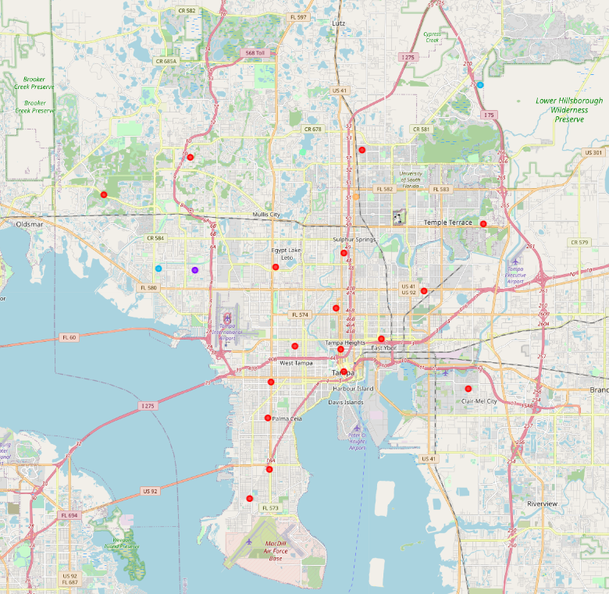
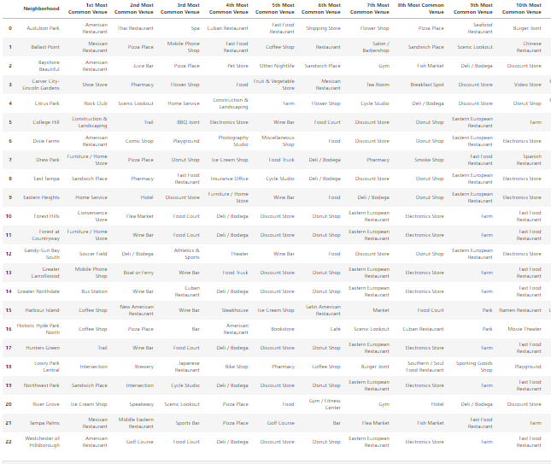
Result
Cluster 1 red, cluster 2 blue, cluster 3 purple and cluster 4 orange
Clustering Similar Neighborhoods
Grouping based on common venues

Slide 9
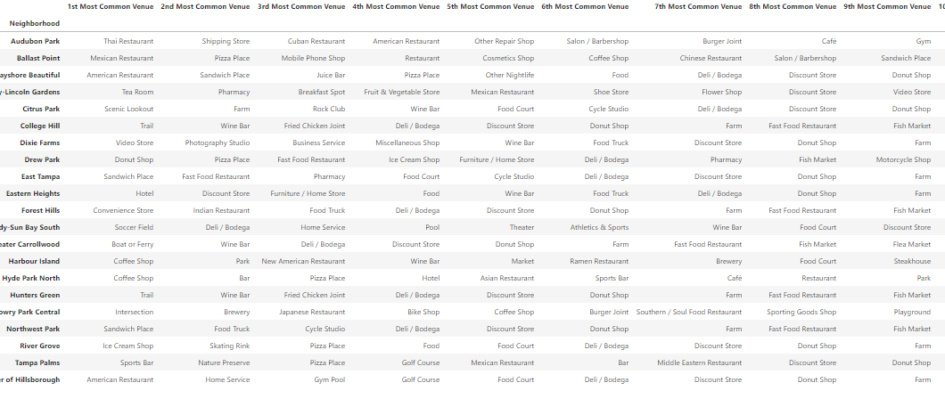
Discussion
Recommedation Summary:
Region: First Cluster
Neighborhood Audubon Park
Additional Offering: American Food

Slide 10
Conclusion
In this report we established a methodology to determine what the most promising type of restaurant is, and where it should be opened.
This type of analysis can be applied to any city of your choice that has available geospatial information-
Result Review:
First cluster looks to offer the best business expansion opportunity.
Audubon park neighborhood in the first cluster looks to meet the key business criteria wherepy it will offer the highest demand (i.e. high population) and lowest competition (i.e. lower supply).

Slide 11
Conclusion
Recommendation Summary:
Region: First Cluster
Neighborhood: Audubon park
In this report we established a metology to determine what the most promising type of restaurant is, and where it should be opened.
This type of analysis can be applied to any city of your choice that has available geospatial information.
This type of analysis can be applied to anyt type of venue (shopping, etc). ) that is available in Forsquare dateabase.
Thank You:
Appreciation Notes from Data Science Team for this project.

